Slide 1
FA With Output… Moore Machine
-- Sakshi Surve

Slide 2
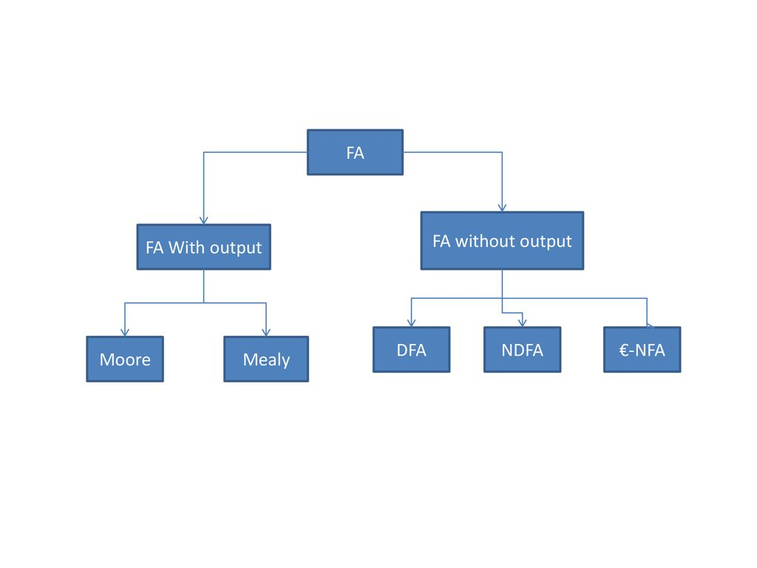

Slide 3
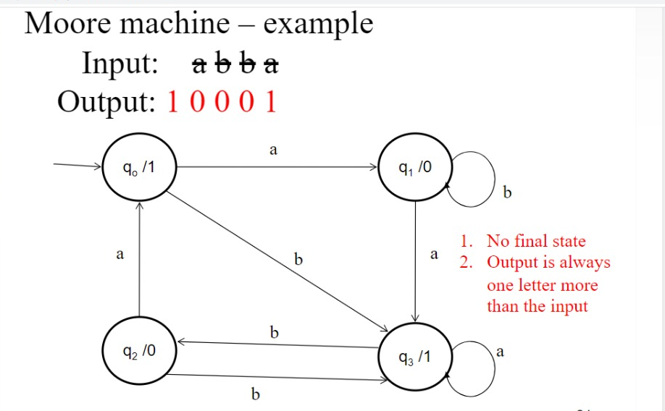

Slide 4
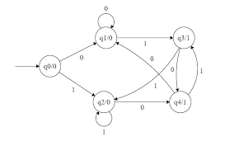

Slide 5
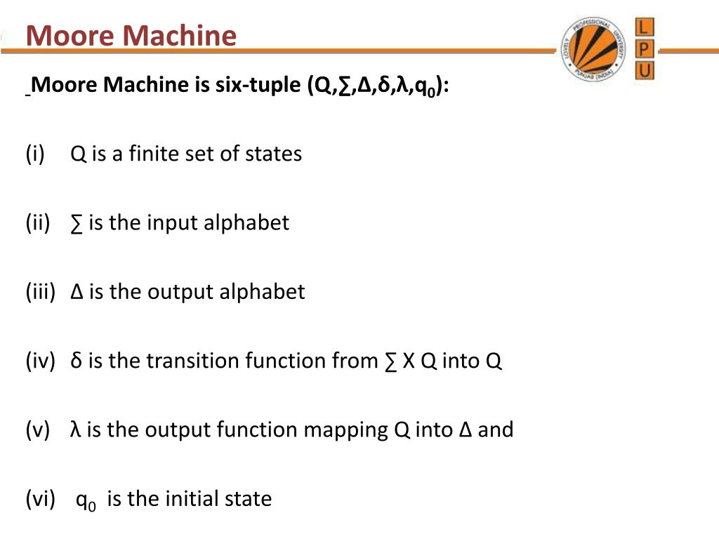

Slide 6
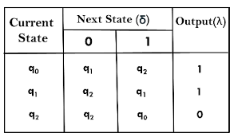
Mapping Functions :

Slide 7
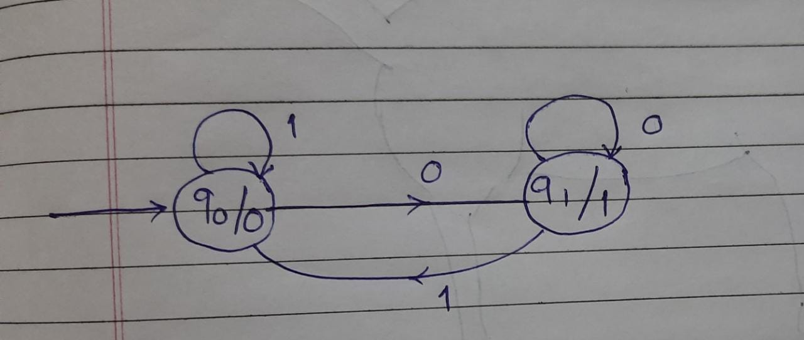
Design Moore Machine to find one’s complement of a binary input string

Slide 8
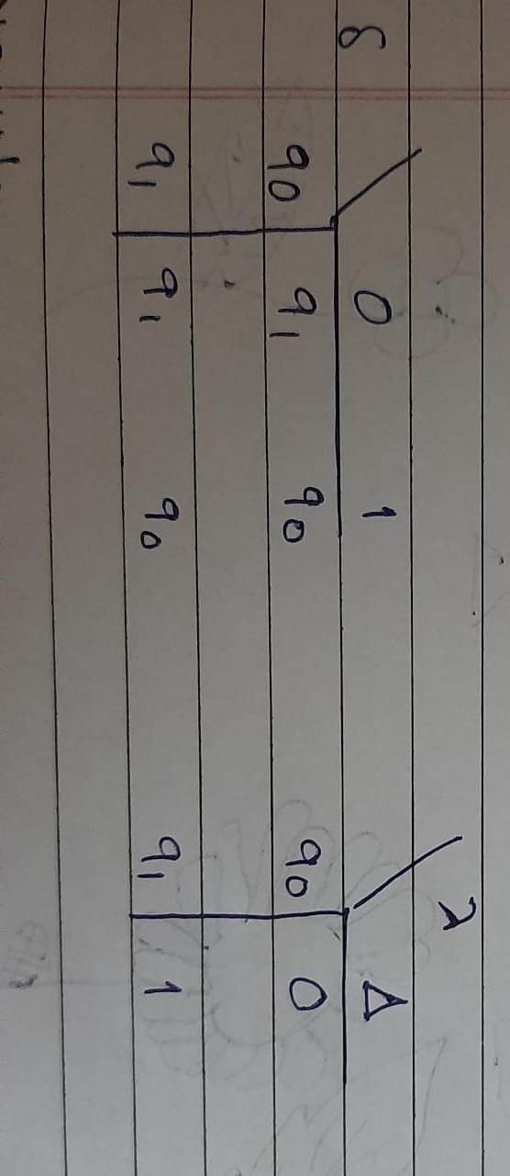
Transition Mapping Function
Output Mapping Function

Slide 9
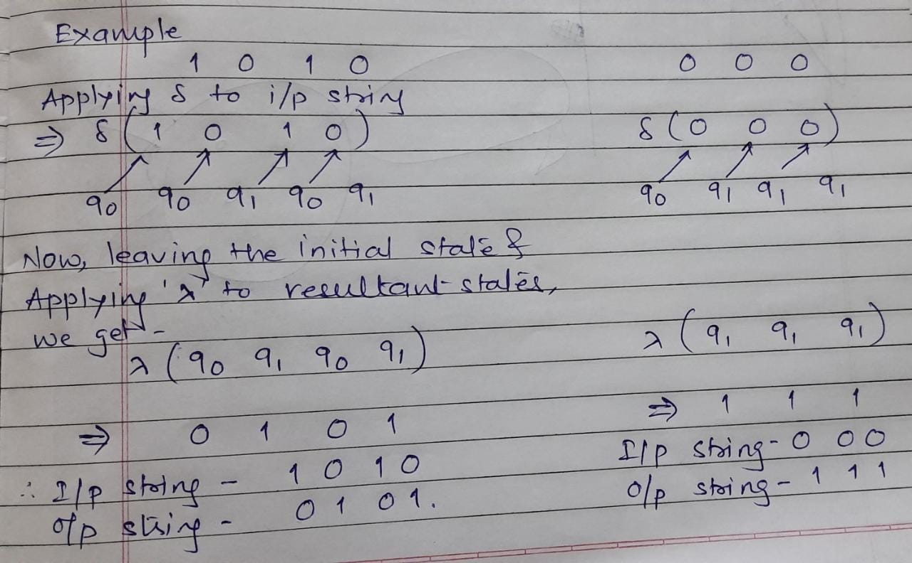

Slide 10
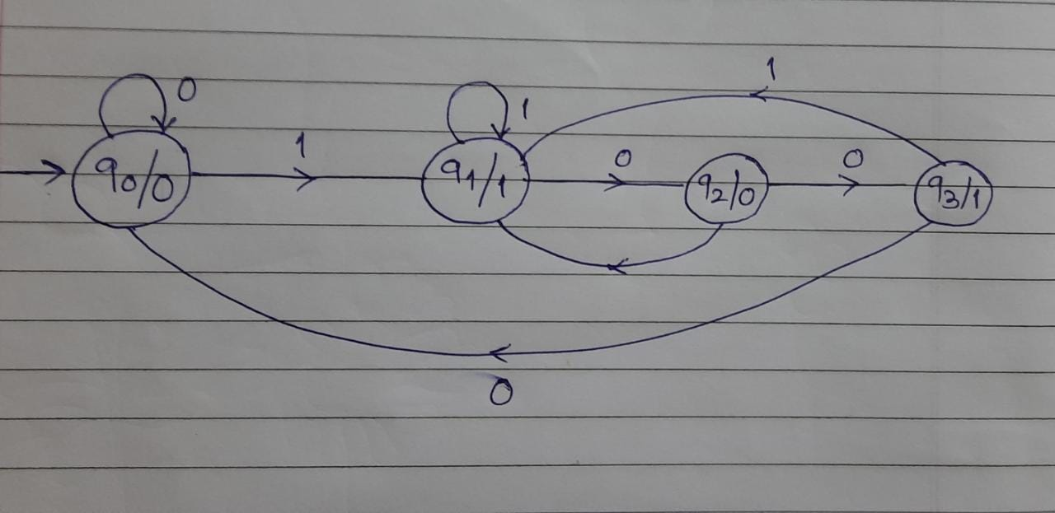
Design Moore Machine to convert every occurrence of 100 to 101

Slide 11
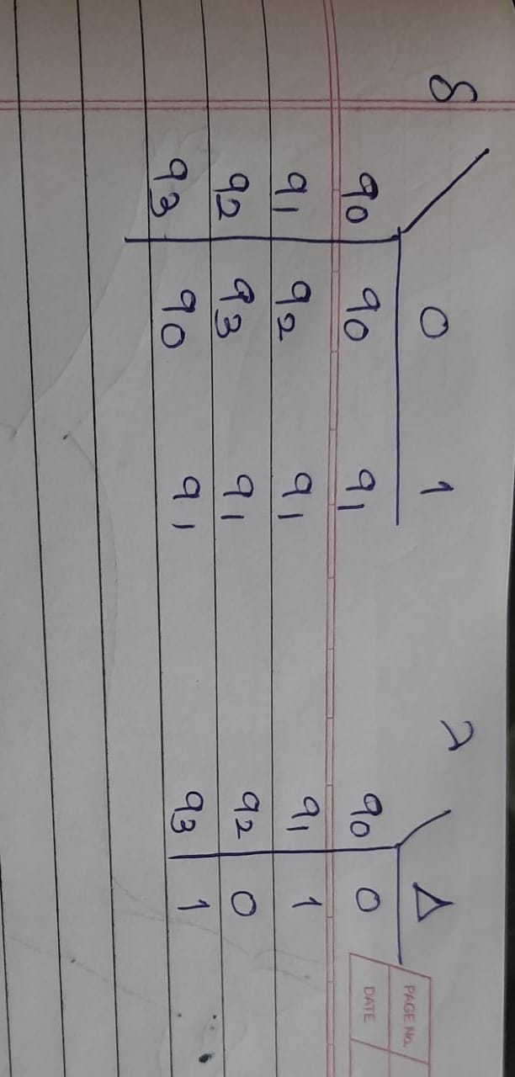
Transition Mapping Function
Output Mapping Function

Slide 12
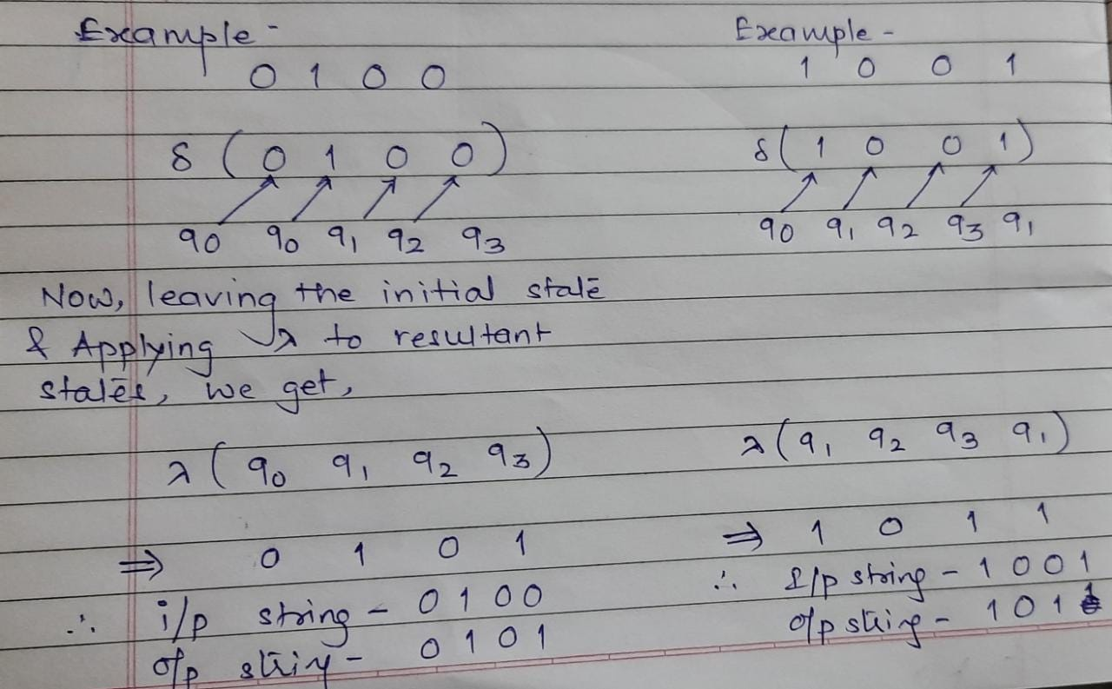

Slide 13
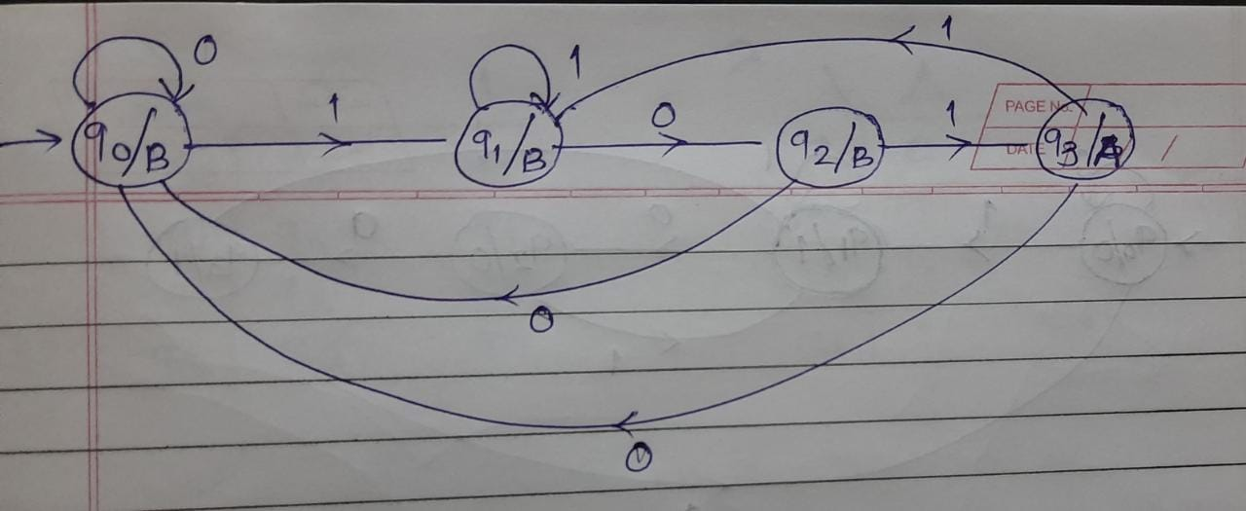
Design Moore Machine which outputs ‘A’ if ‘101’ is recognized , otherwise outputs ‘B’

Slide 14
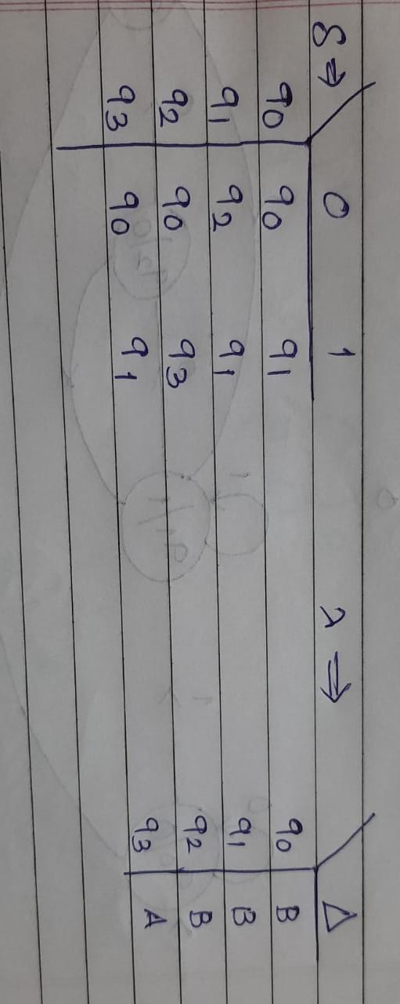
Transition Mapping Function
Output Mapping Function

Slide 15
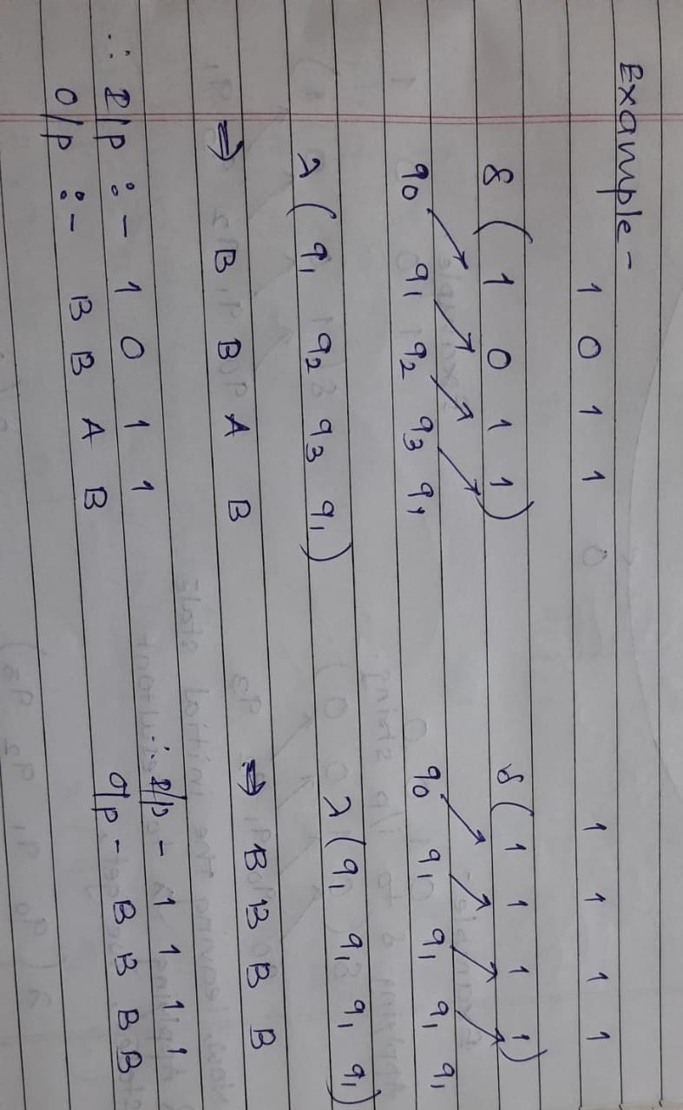

Slide 16
Homework
Design Moore Machine which outputs ‘A’ if ‘101’ is recognized , outputs ‘B’ if ‘110’ is recognized, and ‘C’ otherwise
Design a Moore machine to convert every occurrence of ‘121’ to ‘122’ over ∑ = {1,2,3}

Slide 17
